Slide 1

A Single Group of Sharing Users
user₁
user₃
SyncServerII server
user₂
user₄

Slide 2
SyncServerII server
SyncServerII server
Actual master version for a sharing group:
N + K, K >= 1
Actual master version for a sharing group: N
1) Request
2) Response
1) Request
2) Response
Last known master version for sharing group: N
Last known master version for sharing group: N
user
user

Slide 3
SyncServerII server
SyncServerII server
Updated content and/or appMetaData for file X
File X deleted
Content download conflict
Download deletion conflict
Change to content and/or appMetaData for file X or deletion
Change to content and/or appMetaData for file X
user
user

Slide 4
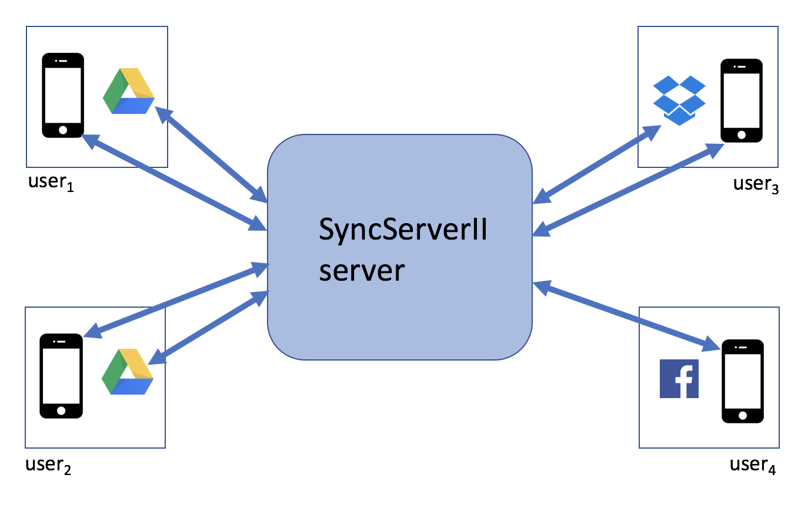
Multiple Groups of Sharing Users
...

